Slide 1

Mapping Open Source and AWS
Adrian Cockcroft
AWS VP Cloud Architecture Strategy
@adrianco

Slide 2
Situational Awareness
Amazon Doctrine
Sustainability
Open Source
Topics
Notes:
Education example
New World: Product is interactive online content, customer is end user. Result is a personal learning plan. Engagement and retention
New Needs: Personalization, customer tracking, new channels direct to consumer by passing existing institutions

Slide 3
Business Climate
Notes:
Education example
New World: Product is interactive online content, customer is end user. Result is a personal learning plan. Engagement and retention
New Needs: Personalization, customer tracking, new channels direct to consumer by passing existing institutions

Slide 4

OLD WORLD IT
Marketing analytics
Employees at work
Sales channels
Factories + supply chain

Slide 5

NEW WORLD IT
OLD WORLD IT
Marketing analytics
Employees at work
Sales channels
Factories + supply chain

Slide 6



Mobile employees
NEW WORLD IT
Employees at work
Online marketing
Social media
Continuous supply tracking
Factories + supply chain
Online sales + delivery
Just in time production
IoT connected things

Slide 7
Personalization
Customer analytics
New channels direct to customer
More things, more scale, rapid change
New Needs
Notes:
Education example
New World: Product is interactive online content, customer is end user. Result is a personal learning plan. Engagement and retention
New Needs: Personalization, customer tracking, new channels direct to consumer by passing existing institutions

Slide 8
Amazon Doctrine
Notes:
Education example
New World: Product is interactive online content, customer is end user. Result is a personal learning plan. Engagement and retention
New Needs: Personalization, customer tracking, new channels direct to consumer by passing existing institutions

Slide 9

Customer obsession
Ownership
Invent and simplify
Are right, a lot
Hire and develop the best
Insist on the highest standards
Think big
Bias for action
Frugality
Learn and be curious
Earn trust of others
Dive deep
Have backbone; disagree and commit
Deliver results
Culture
Amazon leadership principles

Slide 10
If you want to know why Amazon did something, it’s because we saw an unmet customer need, an under-served market.

Slide 11
If you want to influence AWS, get our customers to agree they want something.

Slide 12
Pioneer, Settler, Town Planner

Slide 13
Explore, Expand, Extract – Kent Beck
Pioneer, Settler, Town Planner – Simon Wardley
Seed, A-D round, Public Company – VC Firms

Slide 14
Wardley Mapping AWS Doctrine
Pioneer Exploration (pre-launch)
Settler GA and region roll-out
Town Planner Scale and cost optimization
Value chain PRFAQ working backwards
Map Narrative (tenets/situation/actions)

Slide 15
Blockers for Innovation
Organization
Culture
Skills
Finance
Organization Structure
Leadership Systems and Feedback
Training and Compensation
Capex
Versus Opex
Silos Project to Product

Slide 16
Blockers for Innovation
Organization
Service Teams Instead of Projects
Long term product ownership
Continuous delivery
DevOps and “run what you wrote”
Reduce tech-debt and lock-in
Culture
Skills
Finance
Leadership Systems and Feedback
Training and Compensation
Capex
Versus Opex
Silos Project to Product

Slide 17
Blockers for Innovation
Organization
Integrated Business with DevOps: AWS Service Teams - BusProdDevOps?
Business
budget, headcount, goals
Product
customer input, roadmap
Development
continuous delivery of features
Operations
automated global support
Culture
Skills
Finance
Leadership Systems and Feedback
Training and Compensation
CapEx
Versus OpEx
Silos Project to Product

Slide 18
Blockers for Innovation
Organization
Integrated Business with DevOps
Organization Structure and APIs
CEO
Sales VP
Marketing VP
Product Marketing Manager
Services VP
Services GM
Service Manager (2 pizza team)
BusProdDevOps (API)
Culture
Skills
Finance
Leadership Systems and Feedback
Training and Compensation
CapEx
Versus OpEx
Silos Project to Product

Slide 19
Blockers for Innovation
Organization
Reporting and Learning
Monday - Service Team
Review last week’s operations dashboards
Review last week’s revenue/growth/goals
Tuesday – Groups of Services
Roll up reviews
Wednesday – CEO/VP level view of everything
Review all operations, spin the wheel, learnings
Review entire business revenue/growth/goals
Culture
Skills
Finance
Leadership Systems and Feedback
Training and Compensation
CapEx
Versus OpEx
Silos Project to Product

Slide 20
What is the fundamental metric for innovation?

Slide 21
Time to Value
TICKET
How long?
Do some work
Value to a customer

Slide 22
Time to Value
TICKET
Months?
Do some work
Value to a customer

Slide 23
Time to Value
TICKET
Days?
Do some work
Value to a customer

Slide 24
Time to Value
TICKET
Minutes?
Do some work
Value to a customer

Slide 25
There is no economy of scale in software
Smaller changes are better

Slide 26
Less risk
Faster problem detection
Faster repair
Less work in progress
Less time merging changes
Happier developers
Faster flow
Small changes

Slide 27
Time to Value
Learn to do simple things quickly to unblock innovation
Avoid complex one-size-fits-all processes

Slide 28
Mapping Open Source for Kubernetes
Too many projects in the cloud native landscape
All in different stages of evolution
So lets try and put some of them on a map!

Slide 29
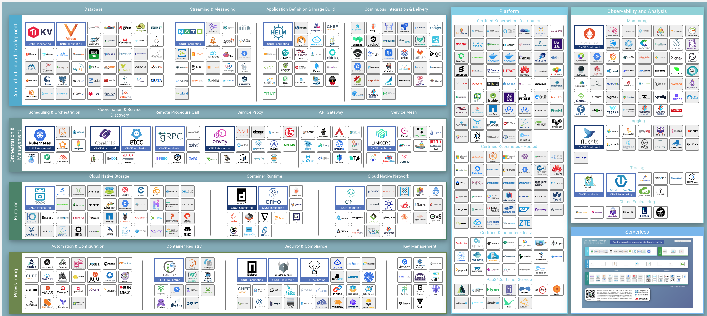
CNCF Landscape https://landscape.cncf.io/zoom=80 – Not a map!

Slide 30
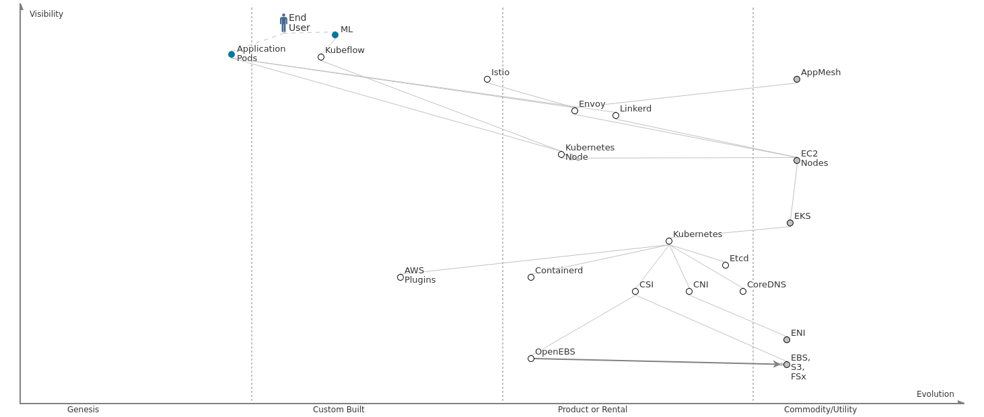
https://atlas2.wardleymaps.com - this is a map! Cloud Native Core
Projects outside CNCF
CNCF Projects
Services

Slide 31
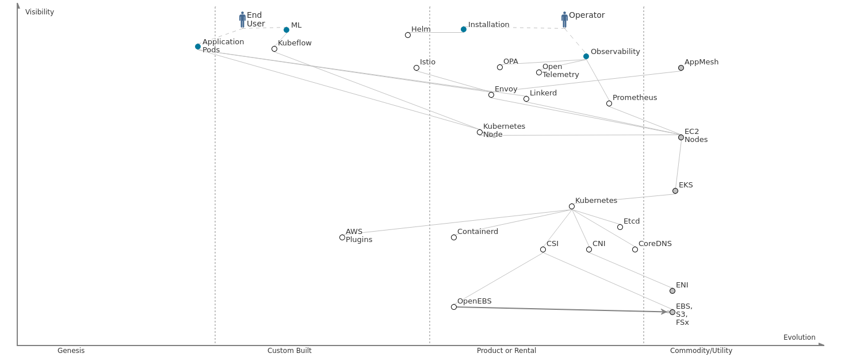
Adding Operations Projects

Slide 32
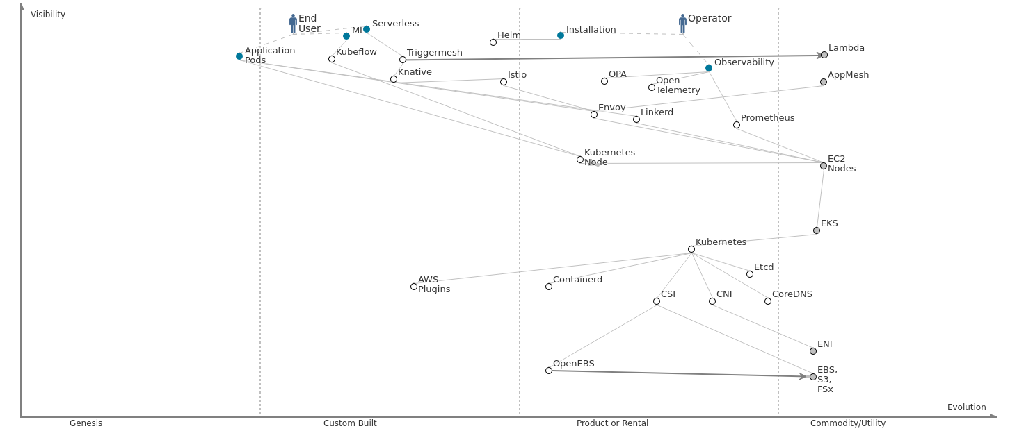
Adding Serverless

Slide 33
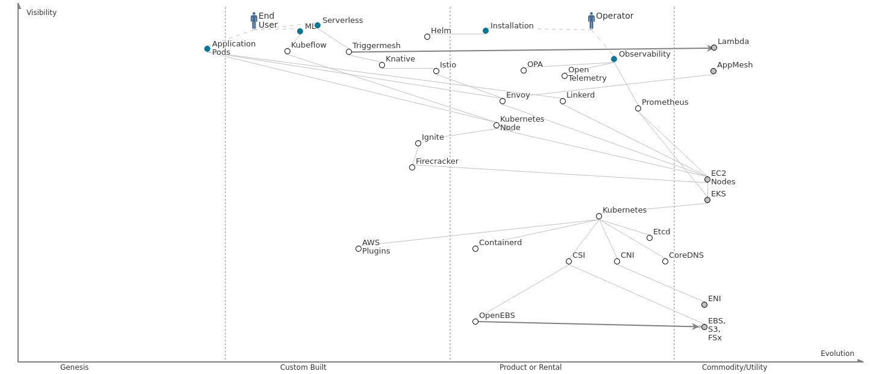
Adding Ignite

Slide 34
Mapping Open Source and AWS
Books list: https://a.co/79CGMfB
Slides and video links:
https://github.com/adrianco/slides
Adrian Cockcroft – AWS - @adrianco

